Slide 1
Epipolar Geometry

Slide 2
Two-view geometry
Epipolar geometry
3D reconstruction
F-matrix comp.
Structure comp.

Slide 3
Three questions:
Correspondence geometry: Given an image point x in the first view, how does this constrain the position of the corresponding point x’ in the second image?
(ii) Camera geometry (motion): Given a set of corresponding image points {x_{i} ↔x’_{i}}, i=1,…,n, what are the cameras P and P’ for the two views?
(iii) Scene geometry (structure): Given corresponding image points x_{i} ↔x’_{i} and cameras P, P’, what is the position of (their pre-image) X in space?

Slide 4
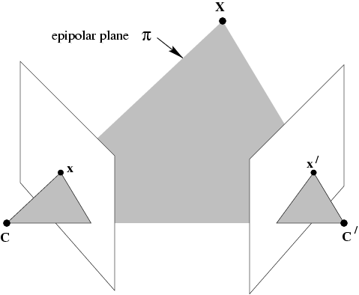
The epipolar geometry
(a)
C,C’,x,x’ and X are coplanar

Slide 5
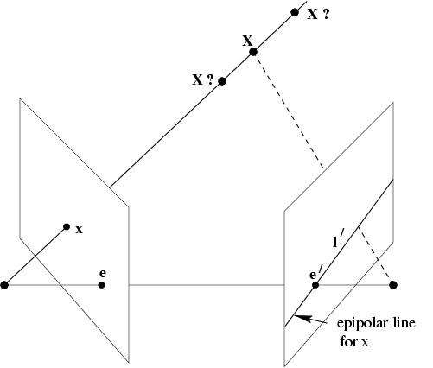
The epipolar geometry
If we know x, how is the corresponding
point x’ constrained?
l’ is the Epipolar line
corresponding to point x
Upshot: if we know C and C’
for a stereo correspondence
algorithm, no need to search
all over the second image,
but just only over the epipolar
line.
C
C’
b
What if only C,C’,x are known?

Slide 6
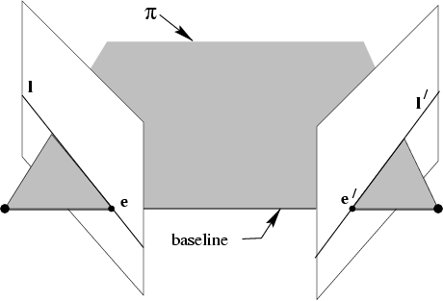
The epipolar geometry
Baseline: connects two camera centers
Epipole: point of intersection of baseline
with image plane
Epipole: image in one view of the camera
center of the other view.
C
C’
a
All points on π project on l and l’

Slide 7
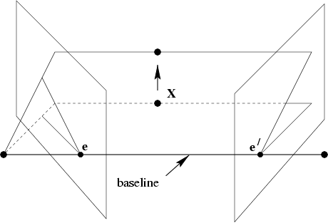
The epipolar geometry
Epipolar plane: A plane containing the baseline.
There is a one parameter family , or a pencil, of epipolar planes
Epipolar line is the intersection of an
epipolar plane with the image plane
All epipolar lines intersect at the epipole
An epipolar plane intersects the left and
right image planes in epipolar lines,
and defines the correspondence
between the lines.
b
Family of planes π and lines l and l’
Intersection in e and e’

Slide 8
The epipolar geometry
epipoles e,e’
= intersection of baseline with image plane
= projection of projection center in other image
= vanishing point of camera motion direction
an epipolar plane = plane containing baseline (1-D family)
an epipolar line = intersection of epipolar plane with image
(always come in corresponding pairs)

Slide 9
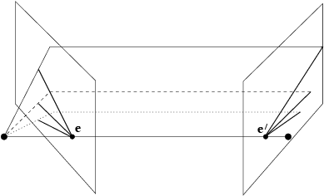
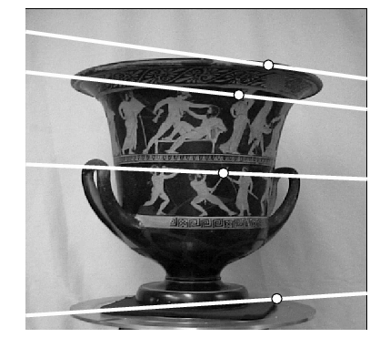
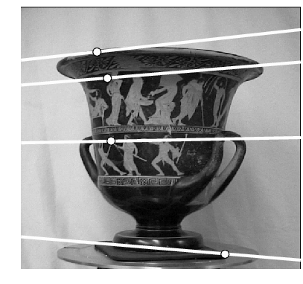
Example:
converging
cameras

Slide 10
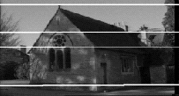
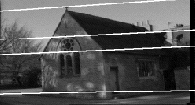
Example: motion parallel with image plane

Slide 11
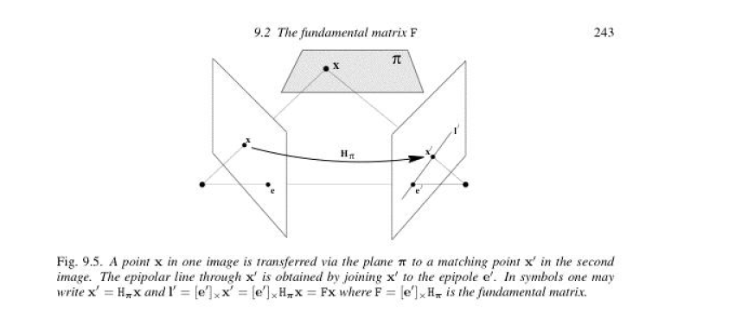
Fundamental Matrix
F is a projective mapping x → l’ from a point x in one image to its
Corresponding epipolar line in the other image
l’ = Fx

Slide 12
The fundamental matrix F
algebraic representation of epipolar geometry
we will see that mapping is (singular) correlation (i.e. projective mapping from points to lines) represented by the fundamental matrix F

Slide 13
Skew Symmetric Matrix for a vector a
[a]_{x} is skew symmetric matrix for vector a
If a = (a₁ , a₂ , a₃ )^{T} then,
[a]_{x} = [ 0 -a₃ a₂
a₃ 0 -a₁
-a₂ a₁ 0 ]
Cross product between two vectors a and be can be written in terms
of skew symmetric matrix for a:
axb = [a]_{x} b

Slide 14
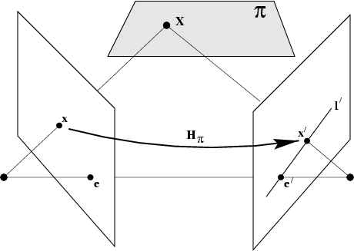
The fundamental matrix F
geometric derivation
Plane π, not passing through either of the
camera centers
Ray through C corresponding to image point
x, meets plane π in a point in 3D called X.
Project X to a point x’ in the second image
“Transfer via the plane π”.
l’ is the epipolar line for x ➔ x’ must like on l’
x and x’ are projectively equivalent to the
planar point set X_{i}
There is a 2D homography mapping
each x_{i} to x’_{i}
C
C’
mapping from 2-D to 1-D family (rank 2)

Slide 15
The fundamental matrix F
algebraic derivation
P⁺ is pseudo inverse of P
Line l’ joints two points: can be written as
cross product of those two points:
First point is P’C which is e’
Second point is projection P’ of P⁺x onto
second image plane
l’ = e’ cross product with ( P’ P⁺ x )
C’
C
(note: doesn’t work for C=C’ ⇒ F=0)

Slide 16
The fundamental matrix F
correspondence condition
The fundamental matrix satisfies the condition that for any pair of corresponding points x↔x’ in the two images
Combine these two:
l’ = Fx
Upshot: A way of characterizing fundamental matrix without reference to
camera matrices, i.e. only in terms of corresponding image points
How many correspondences are needed find F? at least 7.

Slide 17
The fundamental matrix F
F is the unique 3x3 rank 2 matrix that satisfies x’^{T}Fx=0 for all x↔x’
Transpose: if F is fundamental matrix for (P,P’), then F^{T} is fundamental matrix for (P’,P)
Epipolar lines: for any point x in the first image, the corresponding epipolar line is l’ = Fx ; same with converse: l = F^{T} x’ represents the epipolar line corresponding to x’ in the second image
Epipoles: for any point x, the epipolar line l’ = Fx contains the epipole e’. Thus e’^{T}Fx=0, ∀x ⇒e’^{T}F=0; similarly Fe=0
e’ is the left null vector of F; e is the right null vector of F
F has 7 d.o.f. , i.e. 3x3-1(homogeneous)-1(rank2)
F is a correlation, projective mapping from a point x to a line l’=Fx (not a proper correlation, i.e. not invertible)
If l and l’ are corresponding epipolar lines, then any point x on l is mapped to the same line l’ ➔ no inverse mapping➔ F not proper correlation

Slide 18
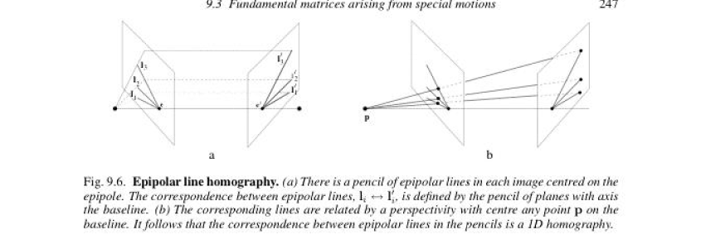
Epipolar Line Homography
Set of epipolar lines in each of the images forms a pencil of lines passing through the epipole
Such a pencil of lines is a 1D projective space
Epipolar lines are perspectively related
There is a homography between epipolar lines centered at e in the first view and the pencil centered at e’ in the second .
A homography between such 1D projective spaces as 3 degrees of freedom
Count degrees of freedom of fundamental matrix: 2 for e, 2 for e’, 3 for 1D homography ➔ total of 7

Slide 19
The epipolar line homography
l,l’ epipolar lines, k line not through e
⇒ l’=F[k]_{x}l and symmetrically l=F^{T}[k’]_{x}l’
(pick k=e, since e^{T}e≠0)
Epipolar Line Homography

Slide 20
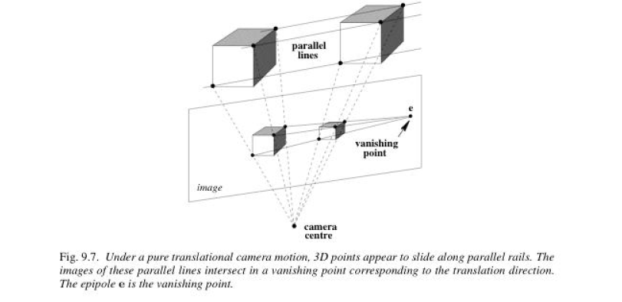
Pure Translation camera motion
Pure translation = no rotation; no change in internal parameters
Pure translation of camera is equivalent to camera is stationary and the
world undergoes a translation –t;
Points in 3 space move on straight lines parallet to t

Slide 21
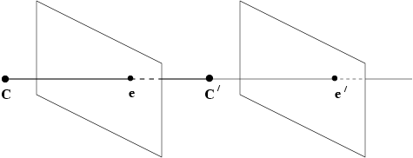
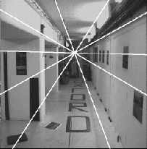
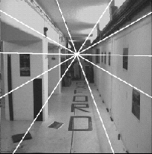
Fundamental matrix for pure translation
a
Forward motion
B c

Slide 22
Fundamental matrix for pure translation
P = K [ I | 0] ; P’ = K [ I | t]
example:
Camera translation parallel to x axis
Z = depth of point X = distance of X from the camera center measured along the principal axis of the first camera
Motion starts at x and moves towards e; extent of motion depends on magnitude of t
and Inversely proportional to Z; points closer to camera appear to move faster than those
further away faster depending on Z➔ looking out of the train window
pure translation: F only 2 d.o.f., x^{T}[e]_{x}x=0 ⇒ auto-epipolar

Slide 23
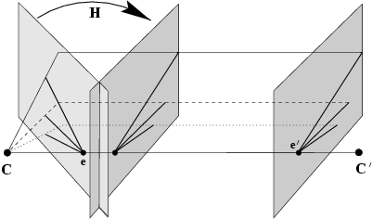
General motion
P = K [I | 0] ; P’ = K’ [R | t];
Rotate the first camera so that it is aligned with the 2nd camera ➔ projective transformation
Further correction to the first image to account for differences in calibration matrices
Result of these two corrections is projective transformation H of the first image: H = K’ R K⁻¹
Then the effective relation between 2 images is pure translation
First term depends on image position, x, but not point’s depth Z, and takes into account camera rotation R and change of internal parameters
Second term depends on depth, but not image position x, and takes account of translation

Slide 24
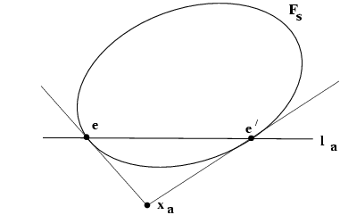
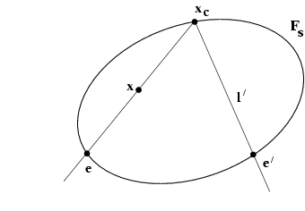
Geometric representation of F
F_{s}: Steiner conic, 5 d.o.f.
F_{a}=[x_{a}]_{x}: pole of line ee’ w.r.t. F_{s}, 2 d.o.f.

Slide 25
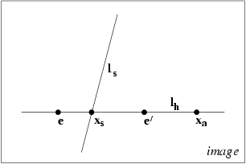
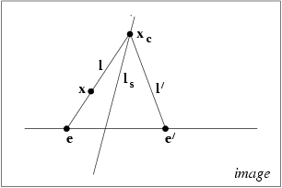
Pure planar motion
Steiner conic F_{s} is degenerate (two lines)

Slide 26
Projective transformation and invariance
F invariant to transformations of projective 3-space
Consequence; F does not depend on the choice of world frame
unique
not unique
canonical form for a pair of camera matrices for a given F: Choose first
Camera as P = [I | 0 ]

Slide 27
Projective ambiguity of cameras given F
previous slide: at least projective ambiguity
this slide: no more than projective ambiguity!
~ ~
Show that if F is same for (P,P’) and (P,P’),
there exists a projective transformation H so that
P=HP and P’=HP’
~
~
Upshot: a given fundamental matrix determines the pair of camera matrices
up to a right multiplication by a projective transformation.
P and P’ each have 11 dof ( 3 x 4 – 1 = 11). Total of 22 dof for both;
Projective world frame H has ( 4 x 4 – 1= 15 ) dof;
Remove dof of world frame from the two cameras: 22 – 15 = 7 = dof of Fundamental matrix.

Slide 28
Canonical cameras given F
F matrix corresponds to P,P’ iff P’^{T}FP is skew-symmetric
Possible choice: S = [e’]_{x}

Slide 29
The essential matrix
~fundamental matrix for calibrated cameras; remove K to get Essential matrix
P = K [ R | t]; x = PX; known K ➔ = K⁻¹ x = [ R | t ] X
is the image point expressed in normalized coordinates;
image of point X w.r.t. camera [R | t] having identity I as calibration matrix
Definition:
Relation between E and F
5 d.o.f. (3 for R; 2 for t up to scale)

Slide 30
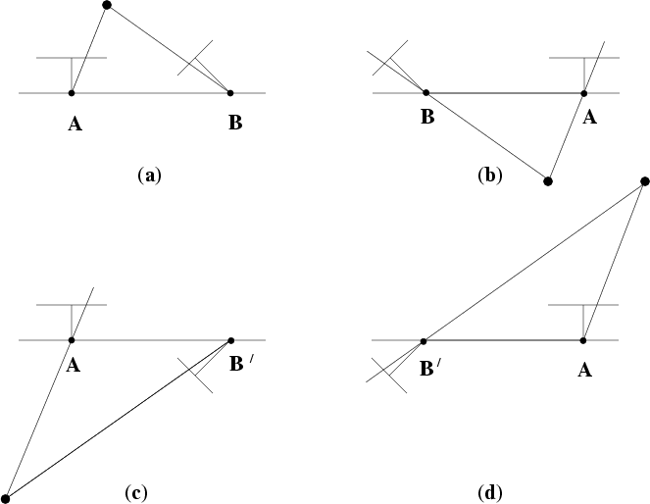
Four possible reconstructions from E
(only one solution where points is in front of both cameras)

